Slide 1



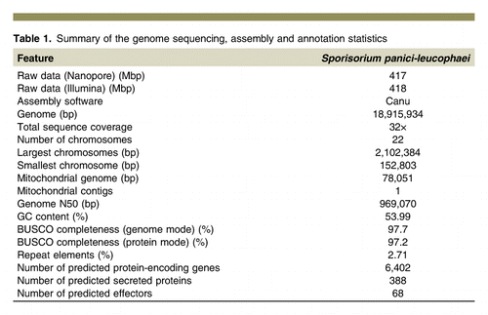






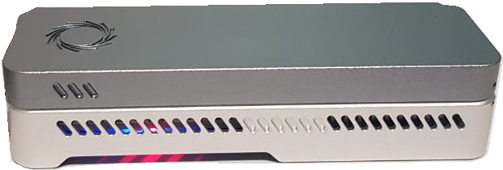


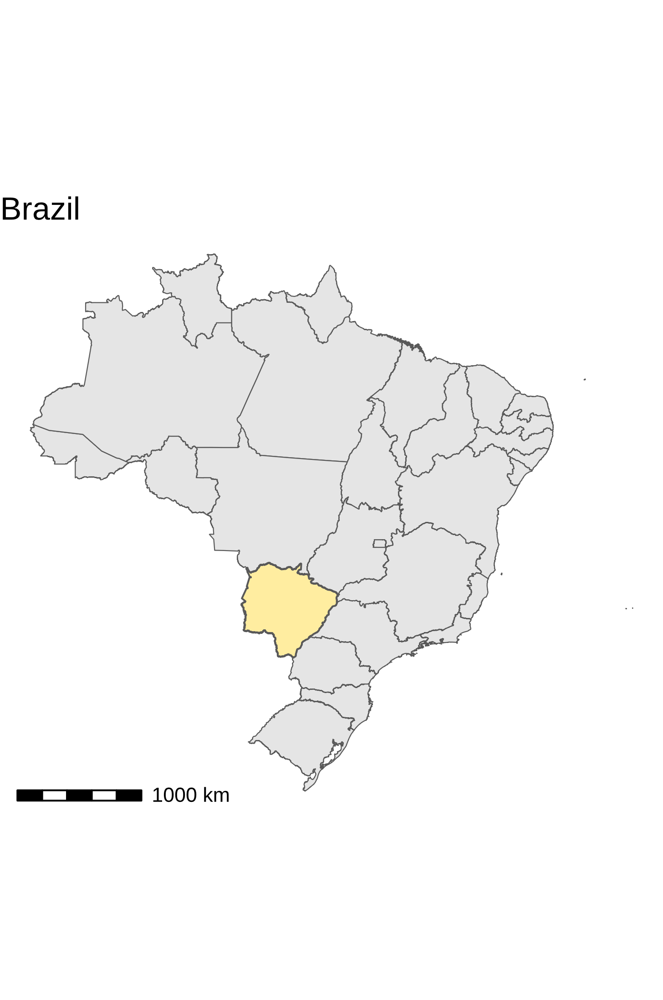
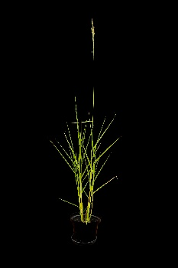
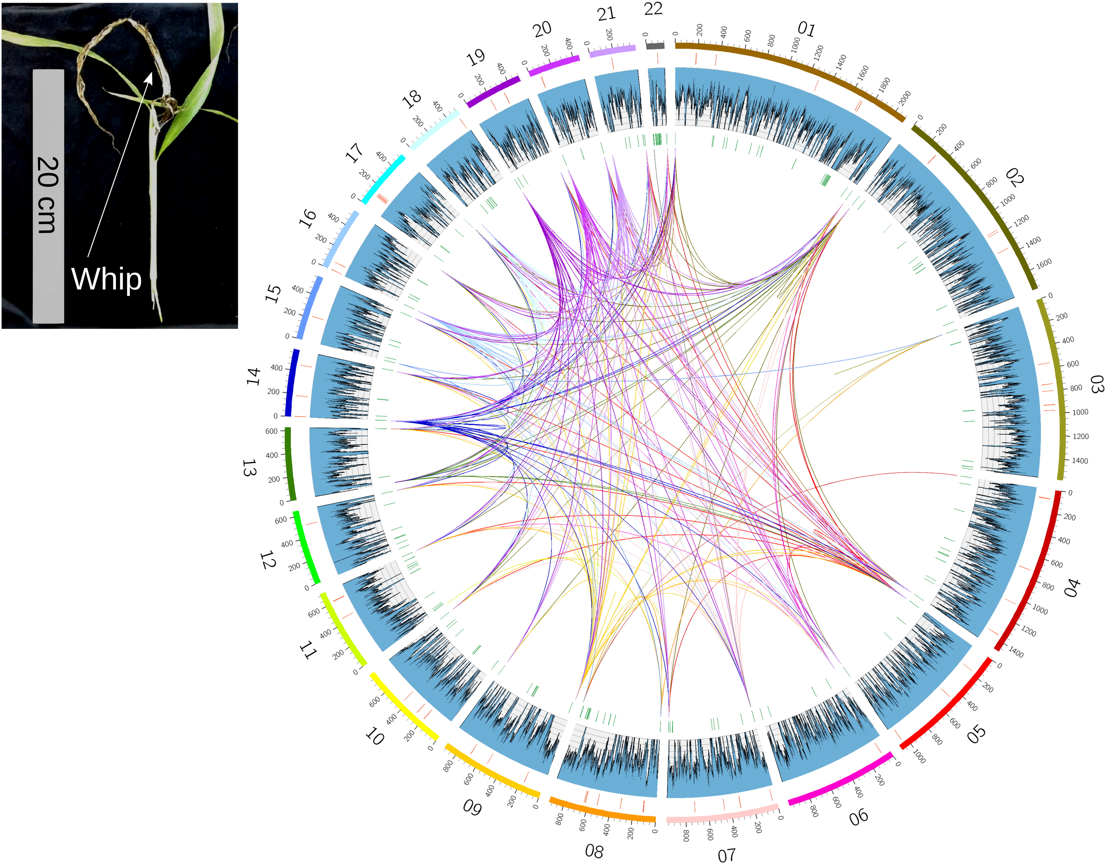




5th IMPB
INTERNATIONAL MEETING ON PLANT BREEDING
INTEGRATED DATA ANALYSIS AS A TOOL TO REVOLUTIONIZE PLANT BREEDING
GENOMICS INSIGHTS FROM THE FIRST CHROMOSOME-SCALE GENOME OF THE SOURGRASS SMUT FUNGUS USING OXFORD NANOPORE READS
Gustavo Schiavone Crestana¹*; Lucas Mitsuo Taniguti², Claudia Barros Monteiro-Vitorello¹
¹ USP/ESALQ. *gustavo.crestana@usp.br
² Mendelics Análise Genômica
Introduction
Materials and methods
Commonly called sourgrass, Digitaria insularis (L.) Fedde is a perennial weed with invasive behavior and has gained relevance in recent years due to its high tolerance to Glyphosate, generating high production cost for farmers. Sourgrass is also a host to the smut fungi Sporisorium panici-leucophaei that infects seedlings of Digitaria insularis, responsible for the sourgrass smut disease. Symptomatically, the disease resembles another one caused by S. scitamineum in sugarcane, producing a whip-like structure from the apex of the plants where sporogenesis takes place. Despite similarities with sugarcane smut, genomic information is scarce about this pathosystem.
Fungal Isolation
DNA extraction
FASTq
MinION/Illumina
NGS Data
Crestana, G. S., Taniguti, L. M., Dos Santos, C. P., Benevenuto, J., Ceresini, P. C., Carvalho, G., Kitajima, J. P., & Monteiro-Vitorello, C. B. (2021). Complete Chromosome-Scale Genome Sequence Resource for Sporisorium panici-leucophaei, the Causal Agent of Sourgrass Smut Disease. Molecular Plant-Microbe Interactions, 34(4), 448-452. DOI:10.1094/MPMI-08-20-0218-A
In silico analysis
Gene/Secretome prediction
Effectorome prediction (EffectorP)
CANU
Conclusion
Fig. 1. Fugal spores were isolated in Selvíria, MS, Brazil.
Genome Assembly
https://github.com/lmtani/​leucophaei-assembly
To the best of our knowledge, this is the first smut and also S. panici-leucophaei genome sequence assembled with nanopore reads. The complete genome of this poorly studied fungus will provide a valuable resource for future studies as a biocontrol agent against D. insularis.
Results and discussion
Objective
Acknowledgments
The objective of our project was to sequence, for the first time, the complete genome of S. panici-leucophaei using Nanopore long reads and predict the fungi effector repertoire.

